Slide 1
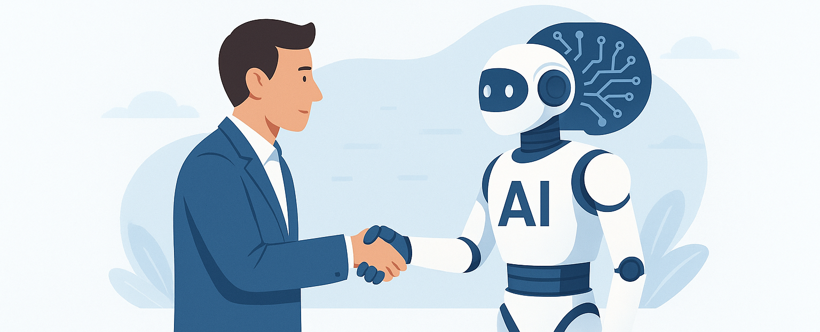
Lecture 3 Chatbots & Virtual Assistants
Dr. Ahmed Yousry
Faculty of Computers and Artificial Intelligence
ahmed.abdelsatar@fci.bu.edu.eg

Slide 2
What is a Chatbot?
A chatbot is an AI-based or rule-based program that interacts with users through text or voice.
It simulates human conversation to help users perform tasks or get information.
Used on websites, apps, and messaging platforms for instant communication.

Slide 3
Types of Chatbots (Rule-based vs. AI-powered)
Rule
Rule-based chatbots: Follow fixed scripts or logic trees.
Use
AI-powered chatbots: Use NLP and machine learning to understand and adapt to context.
Learn
AI bots can learn from user interactions to improve over time.

Slide 4
Virtual Assistants Overview
Advanced chatbots that can perform actions like scheduling, searching, or controlling devices.
Combine speech recognition, NLP, and automation.
Examples: Siri, Alexa, Google Assistant.

Slide 5
Siri Introduction
Developed by Apple, integrated across iOS devices.
Performs tasks like sending messages, setting reminders, and playing music.
Learns user habits to improve personalization.

Slide 6
Alexa Introduction
Amazon’s voice assistant for Echo smart devices.
Controls smart home appliances, plays media, provides news updates.
Supports thousands of third-party skills and IoT integrations.

Slide 7
Google Assistant
Developed by Google and powered by deep learning.
Understands context and maintains multi-turn conversations.
Integrates with Android devices and Google ecosystem (Calendar, Maps, Gmail).

Slide 8
ChatGPT & Generative AI
ChatGPT: An AI language model developed by OpenAI using GPT architecture.
Generative AI: Creates new content like text, code, or images.
ChatGPT can explain, summarize, translate, and generate creative text.

Slide 9
Customer Service Chatbots
Automate FAQs, ticketing, and customer queries.
Provide 24/7 support and reduce wait times.
Improve user satisfaction and reduce operational costs.

Slide 10
AI in Online Shopping Support
Recommends products based on behavior and preferences.
Assists with order tracking, returns, and promotions.
Example: Sephora’s virtual artist and H&M’s style bot.

Slide 11
Voice Interaction vs. Text Interaction
Voice: Natural, fast, and hands-free – great for multitasking.
Text: Private, detailed, better for complex tasks.
Future: Hybrid systems combining both modes.

Slide 12
Multilingual Chatbots
Use NLP and translation to support multiple languages.
Enable businesses to reach global audiences.
Adjust tone and phrasing based on cultural context.

Slide 13
Chatbots in Education
Assist in teaching, answering questions, and automating grading.
Provide personalized learning and tutoring support.
Example: Jill Watson – AI teaching assistant at Georgia Tech.

Slide 14
Chatbots in Healthcare
Book appointments, send reminders, and track medication schedules.
Provide basic symptom checks and mental health support (Woebot, Wysa).
Reduce administrative workload in hospitals.

Slide 15
Limitations of Chatbots
Struggle with emotions, sarcasm, and complex context.
Risk of giving inaccurate or biased responses.
Depend heavily on training data and internet connectivity.

Slide 16
Human Trust in Chatbots
Built through accuracy, transparency, and empathy.
Users prefer bots that clearly identify as AI.
Consistency and emotional tone increase user trust.

Slide 17
Design Challenges
Managing multiple intents in a single query.
Maintaining brand personality and tone.
Ensuring privacy, data protection, and smooth UX.

Slide 18
Benefits of Chatbots
24/7 availability and instant response time.
Reduce costs and scale efficiently.
Improve customer engagement and satisfaction.

Slide 19
Future Role of Chatbots
Integration with AR/VR and IoT for immersive experiences.
Emotionally intelligent AI through sentiment analysis.
Predictive chatbots that anticipate user needs.

Slide 20
Case Study: Banking Chatbot
Example: Bank of America’s 'Erica'.
Provides spending insights, reminders, and financial advice.
Resulted in faster service and higher engagement.

Slide 21
Summary
Chatbots evolved from basic scripts to intelligent assistants.
Used across education, healthcare, banking, and retail.
The future: empathetic, intelligent, and human-centered AI communication.

Slide 22

Thanks

